Slide 1



Symbiosis Institute of Geoinformatics
An Integrated Study on the Global Blockchain-Enabled Carbon Credit Market: AI-Driven Predictive Modeling, Liquidity Analysis, and Strategic Benchmarking of India’s Framework
BY
Alviya Ali
24070243005

Slide 2

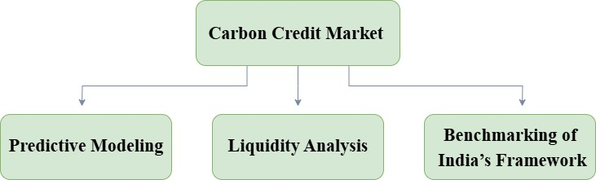
INTRODUCTION
What is Carbon Credit?
What is Carbon Credit Trading?
One carbon credit is the entitlement to emit one metric ton of carbon dioxide or an equivalent amount of other greenhouse gases.
Credits are generated by activities that cut or eliminate emissions like renewable energy, afforestation, or carbon capture, and can be bought and sold among parties wanting to reduce their emissions.
Carbon credit trading enables firms or nations with excess emissions beyond their allowance to buy credits from others who have a surplus, achieving environmental responsibility and economic efficiency.
Blockchain-enabled carbon credit trading works by creating a secure, transparent, and immutable digital ledger for carbon credits.

Slide 3

OBJECTIVES
To build AI-based models based on KlimaDAO's on-chain data (Oct 2021–July 2025) to predict carbon credit market trends.
To study the market liquidity by evaluating trading activity, volatility, and depth in decentralized carbon platforms.
To compare India's changing carbon credit system, shaped by the 2022 Energy Act and future CCTS (2025-26), with international standards.
To examine India's preparedness for integrating blockchain and AI and propose measures for enhancing its digital carbon market infrastructure.
.

Slide 4

RESEARCH QUESTIONS
How effective are AI-driven predictive modeling techniques in forecasting market trends within the blockchain-enabled carbon credit ecosystem using decentralized on chain transaction data from October 2021 to July 2025?
How can liquidity analysis of blockchain-based carbon credit transactions help identify trading patterns, market volatility, and the overall maturity of decentralized carbon markets?
How does India’s carbon credit framework, led by the 2022 Energy Conservation Act and the upcoming CCTS (2025–26), integrate new technologies such as blockchain and AI in comparison to global standards? What technological innovations and infrastructure are needed for India to establish itself as a globally competitive hub in the digital carbon credit economy?

Slide 5
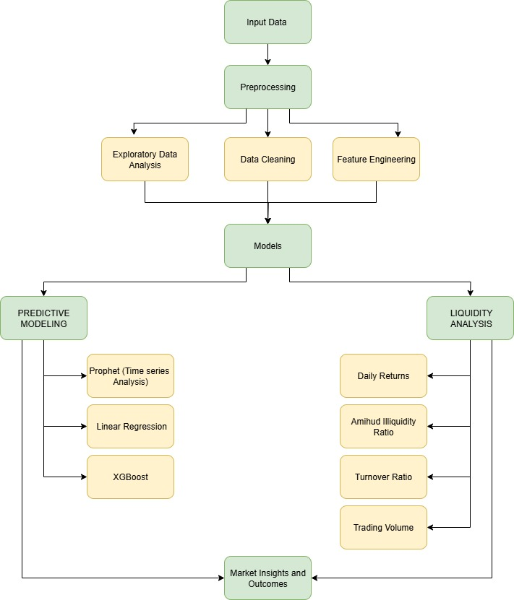
METHODOLOGY
Dataset Used
Exploratory Data Analysis
The data used in this study is the transactional and market data from the blockchain-based carbon credit platform KlimaDAO, covering the period from October 20, 2021, to July 13, 2025.
The columns are: Date, Open, High, Low, Close, Volume, and Market Cap.
Exploratory data analysis was performed to understand the descriptive statistics, trend analysis, correlation studies, and return-based evaluations.
The focus was on determining the price movement, trading, volatility, and long-run market performance of carbon credits.
Data Cleaning
Exploratory data analysis reveals that the carbon credit market experienced an epic bubble in 2021, and then sharply declined and stabilized at a lower level.
Trading volumes were diluted soon, and this became a liquidity issue, particularly among large traders.
Price movements are highly sensitive to policy announcements and compliance cycles, indicating the market is event sensitive.
The column names were first cleaned in terms of removing the unnecessary symbols, whitespaces, and reducing spaces by underscores.
All the important financial variables were then coded in numeric form. Commas and symbols or signs of any non-numeric values were removed.
Date column was changed into the standardized datetime format.

Slide 6

RESULTS AND DISCUSSION
Liquidity Analysis
Predictive Modeling
Liquidity is a critical measure of market efficiency, indicating how easily assets can be traded without causing significant price fluctuations.
Two metrics were used to assess the liquidity: Amihud Illiquidity Ratio and the Turnover Ratio.
Predictive modelling captures short-term fluctuations while forecasting future dynamics, event-driven shifts, and non-linear patterns in carbon credit pricing.
In this study, three predictive techniques were used: Linear Regression, Prophet (time-series forecasting), and XGBoost.
Benchmarking of India’s Framework
India’s carbon credit scheme, started under the 2022 Energy Conservation Act and the CCTS in 2024, allows companies to buy and sell credits to lower their carbon impact.
The CCTS sets targets for 2025–26 and 2026–27, and actual trading of carbon credits will begin in late 2026.

Slide 7
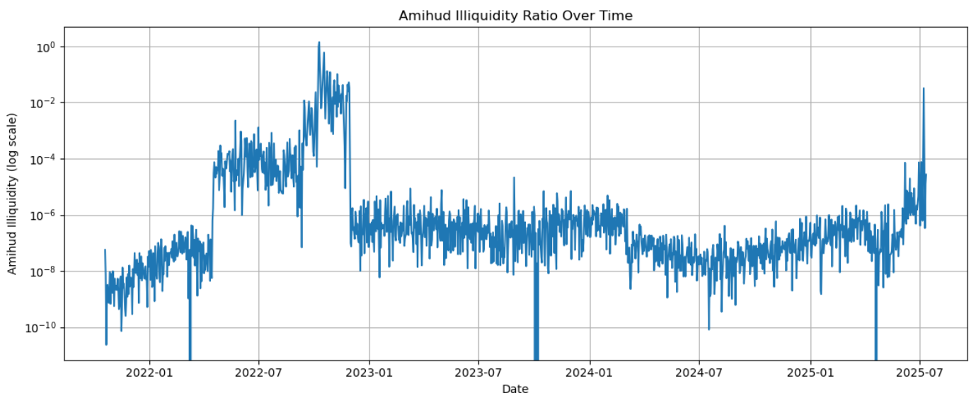
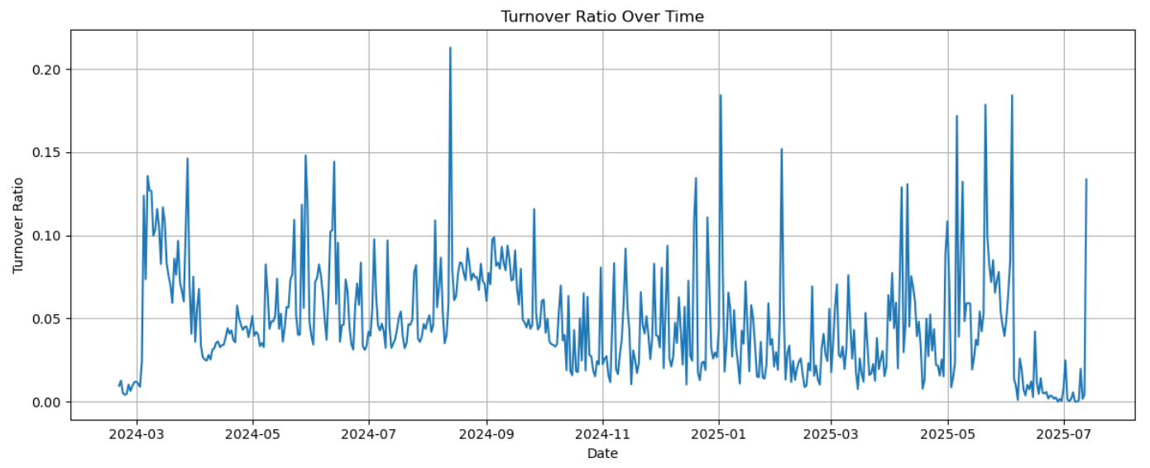
Liquidity Analysis
Amihud Illiquidity Ratio
Turnover Ratio
The Amihud Illiquidity Ratio shows how much a trade moves the price compared to the trading volume, found by dividing price change by the number of shares traded.
Between 2022 and 2025, the Amihud Illiquidity Ratio in the carbon credit market showed stable phases with sudden spikes, where small trades caused large price changes. These shocks, especially in 2022–23 and mid-2025, were likely driven by compliance deadlines, new regulations, or shifts in carbon offset demand.
The Turnover Ratio measures how actively a market is trading by comparing the trading volume to the total market value, showing how often assets are bought and sold.
The turnover ratio of carbon credits between 2024 and 2025 mostly stayed between 0.02 and 0.10, with short spikes up to 0.20 during compliance or policy shifts. Longer periods below 0.05 show thin trading and low participation, highlighting that carbon markets are less active than regular financial markets.

Slide 8
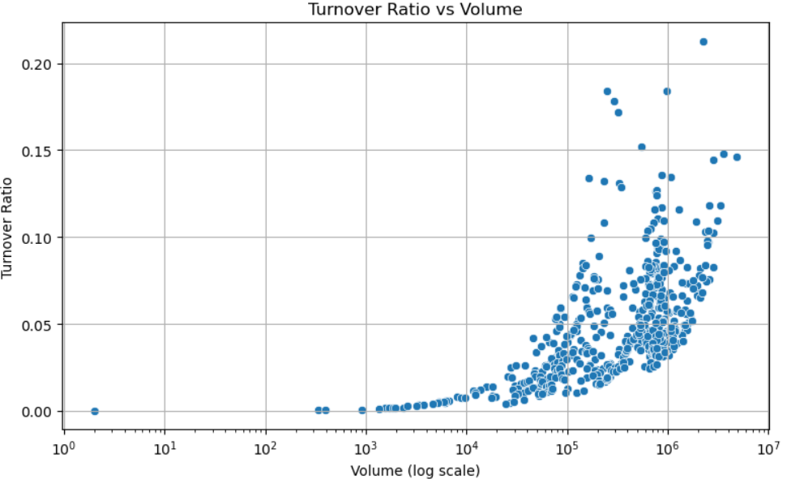
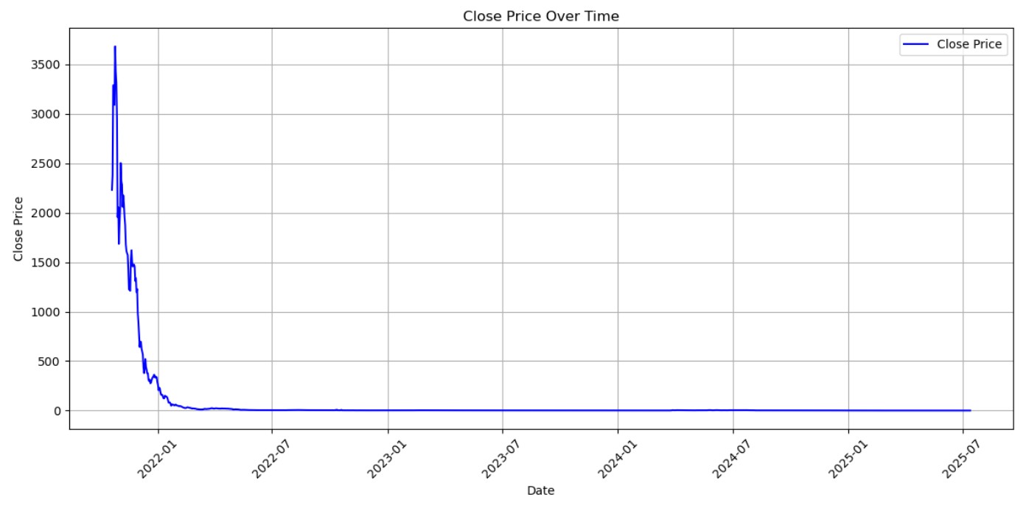
Liquidity Analysis
Relationship Between Turnover Ratio and Trading Volume
Closing Price Trend
The scatter plot shows that there is a precise positive correlation between the trading volume and the turnover ratio.
Turnover ratios are very low (under 0.02) when trading volumes are small, showing low liquidity. As volumes rise to 10⁵–10⁶, ratios increase to 0.15–0.20, indicating better liquidity and more participation. This shows that high trading, especially near compliance dates, boosts liquidity, while low-volume days have little effect.
In the early days, prices were very volatile, reaching a high of $3,694.5 in early 2021 and dropping almost 98% to $0.12, with an average price of $162.4 but a median of only $7.8, showing uneven distribution.
After 2022, the market became stable, with prices mostly below $10 and small fluctuations, showing it moved from a speculative bubble to a more mature market.

Slide 9
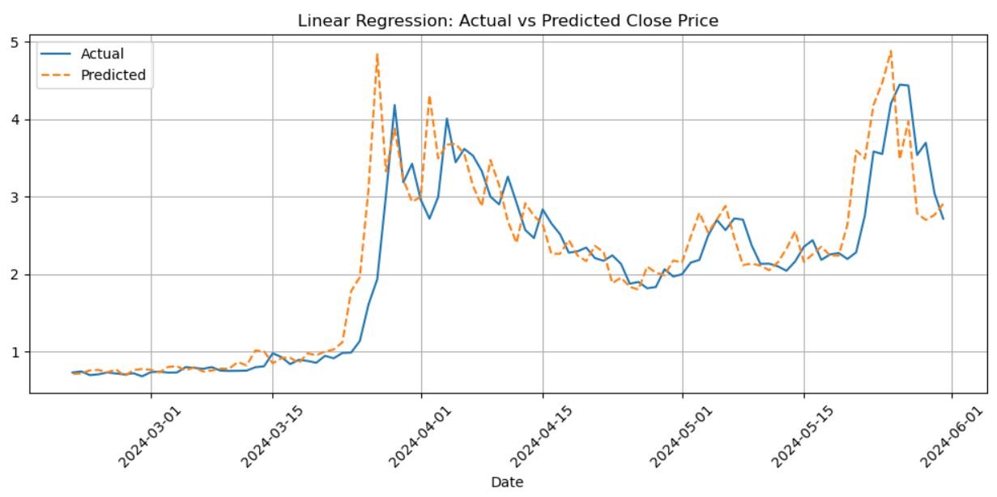
Predictive Modeling
Linear Regression
Linear regression model demonstrates that there is a strong correspondence between the real and forecasted carbon credit prices during the test period (March to June 2024).
The model also adequately fits the overall rising and falling trends, especially in the times when the prices are on a spike (e.g., the March 2024 peak of approximately 4.8 units). It is however, a bit overestimates when there is a sharp increase and underestimates when there is a sharp decrease and is therefore sensitive to volatility.
This indicates that linear regression would be fine during the short run, but it is incapable in capturing non-linear and event-driven changes in carbon credit markets.

Slide 10
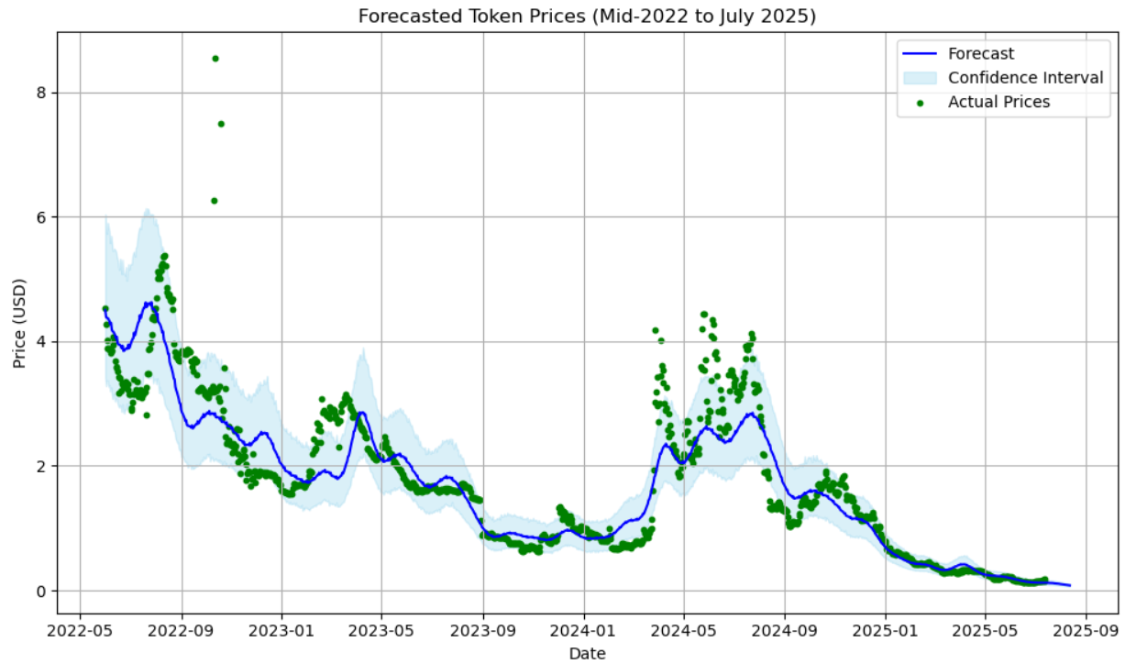
Predictive Modeling
Time-Series Forecasting using Prophet
The Prophet time-series forecasting model was implemented between mid-2022 and July 2025, and it can offer both the predicted prices and the confidence intervals.
The model is also useful in capturing seasonal changes and cyclical price corrections, which are in line with the observed real trends.
In comparison with linear regression, Prophet is more appropriate for strategic forecasting of carbon credit prices because it can adapt to long-term trends and event fluctuations.
The Prophet model was further used to predict prices in carbon credits from 14 July to 12 August 2025, and then the predictions were compared with the actual KlimaDAO market prices during the same period. The expected trend was relatively close to the market values, implying that Prophet is not only useful in long-term seasonality and trends but also useful in short-term forecasting.

Slide 11
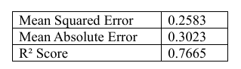
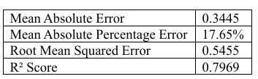
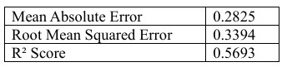
Predictive Modeling
Linear Regression
Time-Series Forecasting using Prophet
XGBoost
In the case of the Linear Regression model, the model was able to produce a Mean Squared Error (MSE) of 0.2583. The Mean Absolute Error (MAE) was 0.3023, reflecting close alignment between predicted and actual values. This shows the model effectively captures linear patterns present in the trading data.
Lastly, the model achieved a value of R² was 0.7665, which implies that the model explains nearly 76.65 percent of the variation in the dependent variable in a relatively strong fit.
XGBoost model was applied using lag features of one, two, and three days to obtain short-term dependencies on the prices of carbon credits.
The data was divided into training and testing sets without randomization to maintain the time sequence.
The analysis results revealed Mean Absolute Error of 0.2825, Root Mean Squared Error of 0.3394, and R² of 0.5693, indicating that XGBoost had relatively low prediction errors but was not able to capture the overall variation in price changes, and it is therefore ineffective in long-term forecasting compared to Prophet.
The Prophet model achieved a Mean Absolute Error (MAE) of 0.3445 and a Mean Absolute Percentage Error (MAPE) of 17.65%, indicating reasonable accuracy in absolute and relative terms..
RMSE error was 0.5455, and the R² value of 0.7969 showed that the model was able to explain nearly 80% of the variance in carbon credit trading trends, demonstrating strong predictive capability for time series forecasting.

Slide 12

Benchmarking of India’s Framework
Current State of Technology Usage
Global Benchmarking
The carbon credit trading system(CCTS) in India is based on digital Monitoring, Reporting and Verification (MRV) to monitor the carbon reduction, and the Bureau of Energy Efficiency (BEE) supervises the processes, and the Accredited Carbon Verification Agency (ACVA) conducts the third-party audit. The issuance and trading of the Carbon credit certificate will be recorded in a national carbon registry under the management of a grid controller of India through electronic platforms.
Carbon markets like the EU ETS and California’s cap-and-trade use modern MRV systems with AI, remote sensing, and digital tools to track and verify emissions accurately.
India’s carbon trading market is still new, lacking digital infrastructure and interoperability, so adopting advanced technologies will help align it with global standards.
Future Requirements for India’s Carbon Market
Gaps and Technological Innovations
The carbon credit system in India has faced low demand, too many credits, high verification costs, poor transparency, and weak links to international markets.
To fix these issues, the system can use better technologies like blockchain for secure records, smart contracts for real-time monitoring, and IoT sensors for industry tracking.
Digital trading platforms can also help secure transactions and keep prices stable.
India should use better monitoring tools and open data, and help small companies report emissions to make the market more transparent and active.
Following the Paris Agreement and involving private companies and startups can increase trust, encourage new ideas, and connect India to global carbon markets.

Slide 13

Conclusion
This study examined the global blockchain-based carbon credit market using liquidity and predictive models. Liquidity analysis showed that while average daily returns were low, there were sudden spikes and high Amihud Illiquidity Ratios, indicating occasional illiquidity and market fragility.
Predictive models confirmed this volatility, with Linear Regression useful for short-term forecasts and Prophet and XGBoost capturing complex patterns and extreme trends.
India’s carbon credit framework follows international standards through the 2022 Energy Conservation Act and upcoming CCTS (2025-26). However, it has yet to adopt technologies like AI and blockchain that drive best practices globally.
Improving digital infrastructure, transparency, and predictive analytics will reduce liquidity risks.
These steps can make India a competitive player in the global carbon credit market.

Slide 14
Thank you!
.

